Slide 1
Car Sales Analysis
Name: Shivasankar T
Mentor: Jaya Pandey

Slide 2
Objective
Understanding customer behavior
Understanding Operational efficiency
Optimize the product management
Cost optimization
Product management
Sales strategies
Inventory Management

Slide 3
Introduction
The Project is about Analysis a Car Sales Database to improve the business by using various attributes like Customer Stratifications, Optimize Operations, Sales Efficiencies, and provide support to enhance the business sales and total revenue

Slide 4
Business Analysis
Top country based on average credit limit
Identify Top 10 customer based on credit limit
Diego Freyre is the customer with highest credit limit
Denmark is the country with highest average credit limit

Slide 5
Business Analysis
Find no of customer in each state
Calculate total sales for each customer
CA State has the more no of customers
The customer number 141 , Euro+ Shopping Channel has the highest total sales

Slide 6
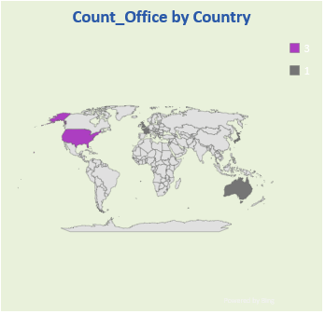
Business Analysis
Find the No of Office in each country
Identify the Customer who have exceed the credit limit
Customer who have placed orders for most expensive products
customernumber | customername | creditlimit
125 | Havel & Zbyszek Co | 0
168 | American Souvenirs Inc | 0
169 | Porto Imports Co. | 0
206 | Asian Shopping Network, Co | 0
223 | NatÃ¼rlich Autos | 0
237 | ANG Resellers | 0
247 | Messner Shopping Network | 0
273 | Franken Gifts, Co | 0
293 | BG&E Collectables | 0
303 | Schuyler Imports | 0
customername | productline | productname | productprice | mostordered | totalquantity
Mini Gifts Distributors Ltd. | Classic Cars | 1952 Alpine Renault 1300 | 214.3 | 2 | 80
Baane Mini Imports | Classic Cars | 1952 Alpine Renault 1300 | 214.3 | 1 | 26
Cambridge Collectables Co. | Classic Cars | 1952 Alpine Renault 1300 | 214.3 | 1 | 29
Displayed top 10 Customer who has exceed the credit limit
Customer Mini Gifts Distributors LTD have placed orders for most expensive products
USA has most No of Office in the country

Slide 7
Business Analysis
Identify the No of Employees working in each office
Find Most profitable office based on Total Sales
Find Average credit limit for customer in each office
The highest No of Employee in office is Office code 1 has 6 Employees
The Most profitable office based on Total Sales is office code 4
Most highest average credit limit for customer is office code 6

Slide 8
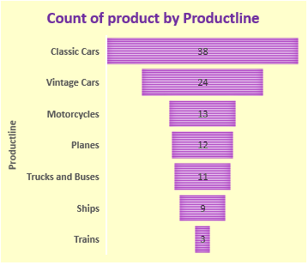
Business Analysis
Find the No of Product for each product line
Find productline with highest average product price
Find the total sales for each product line
Classic cars has highest No of Products in product lines
Classic cars has the highest average product prices in product lines
Classic cars has highest the Total Sales in product lines

Slide 9
Business Analysis
Calculate total sales for each product
Identify the top selling product based on total quantity ordered
Product Ferrari 360 Spider red is in top total sales among all these products which comes under classic cars
Ferrari 360 Spider is the top selling product based on total quantity ordered by the customers

Slide 10
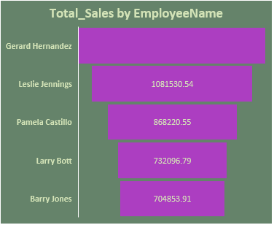
Business Analysis
Find No of Employees in each job titles
Find Employee who has not assigned with Manager
Find most profitable sales representative based on total sales
1260397.81
Employeenumber | Firstname | Lastname
1002 | Diane | Murphy
Sales Rep job title has the most no of Employees
Gerard Hernandez is the most profitable Sales representative
Diane Murphy has not assigned with Manager

Slide 11
Business Analysis
Calculate & find the highest value orders based on total sales
Find No of Orders placed in each month
Retrieve most recent orders based on order date
ordernumber | Recent_orders
10424 | 31-05-2005
10425 | 31-05-2005
10422 | 30-05-2005
10423 | 30-05-2005
10420 | 29-05-2005
10421 | 29-05-2005
10419 | 17-05-2005
10418 | 16-05-2005
10417 | 13-05-2005
10416 | 10-05-2005
ordernumber | total_sales
10165 | 67392.85
10287 | 61402
10310 | 61234.67
10212 | 59830.55
10207 | 59265.14
10127 | 58841.35
10204 | 58793.53
10126 | 57131.92
10222 | 56822.65
10142 | 56052.56
November(11) is the most placed ordered month
Recently placed order is 10424 & 10425
10165 is the highest valued order on total sales

Slide 12
Business Analysis
List the most frequently ordered products
Identify the Delayed shipping order
Identify orders that are pending
ordernumber | status
10334 | On Hold
10401 | On Hold
10407 | On Hold
10414 | On Hold
10420 | In Process
10421 | In Process
10422 | In Process
10423 | In Process
10424 | In Process
10425 | In Process
Ordernumber | Shipped date | Required date
10165 | 26-12-2003 | 31-10-2003
Listed the orders that are on-hold(pending) & in process
!992 Ferrari 360 spider red is the most frequently ordered products
10165 is the order which is delayed in shipping

Slide 13
Business Analysis
calculate revenue for each orders & identify the top 10 most profitable orders
Identify most profitable orders based on total revenue
ordernumber | Total_Revenue
10165 | 67392.85
10287 | 61402
10310 | 61234.67
10212 | 59830.55
10207 | 59265.14
Displayed revenue for each orders & identify the top 10 most profitable 10403 is the most profitable orders
10165 most profitable orders based on total revenue

Slide 14
Summary
The top customers is Euro+ Shopping Channel, contact name is Diego Freyre customer number is 141.
Highest country and state is Denmark with Avg credit limit & CA state with no of customers.
Order patterns: 98 customers placed the orders and 24 customers are not placed any orders.
Product affinity : Three customers placed the orders for most expensive products price of each is 214.30 total quantity of three customer ordered is 135 total sales is 28,930.5
Employee Distributions: Office code 1 has more no of employees with 6 employees followed by office code 4 with 5 employees
Office Profitability: Office 4 has the most profitable in terms of total sales with 3085581.58 followed by office 7 with 1436950.70
Global products: USA has the most no of office with 3 offices and remaining has 1 office.
Product Variety: Classic cars has the most no of varieties of 38 products, followed by Vintage cars with 24 varieties of products.
High performing product lines: Classic cars is the most high performing product lines with 3855742.49
Customer Popularity: From above conclusion the most popular product is 1992 Ferrari 360 Spider Red , total quantity ordered by customer is 1808.

Slide 15
Summary Continues
Total employee count is 23
Diane Murphy employee number is 1002 has not assigned with Manager
Sales Performance: Gerard Hernandez 1370 is the sales representative who achieved the top sales of 397 quantity sold
High Performance: Gerard Hernandez 1370 is the sales representative with high performance in total sales of 1260397.81
Order Volume: The total order volume is 327 and order number 10165 has the highest total sales
Sessional sales: November(11) month has the most no of ordered placed and August(8) month has the least no of ordered placed
Order Status: 4 orders are on ‘Hold’ and 6 orders are in ‘In process’.
High Value orders: 10165 order number is the highest value ordered in terms of total sales
Product Popularity: The popular product is 1992 Ferrari 360 Spider Red , total quantity ordered is 1808.
Profitable Order: The most profitable order is 10165 with 67392.85

Slide 16
Conclusion
Customer Engagement: is the strategic process of building and maintaining meaningful relationships with customers
Credit Management: 24 customers had have exceed the credit limits
Employee Management: Recognize & rewarded the Gerard Hernandez 1370 employee with high performance in total sales of 1260397.81
Product Strategies: The popular product is 1992 Ferrari 360 Spider Red with 276839.98
Order Processing: There is only one order 10165 which was delayed in shipping, Continuously monitored and improved with no delayed in shipping.
These conclusion provides holistic view of business and highlighting the strength & opportunities for improvement across customers engagement, Financial Management ,Employee Management & in Order Processing

Slide 17
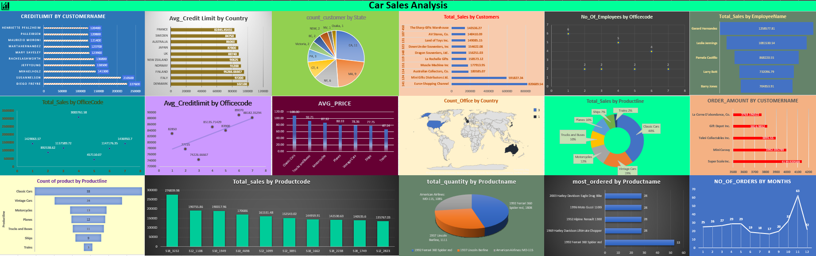

Slide 18

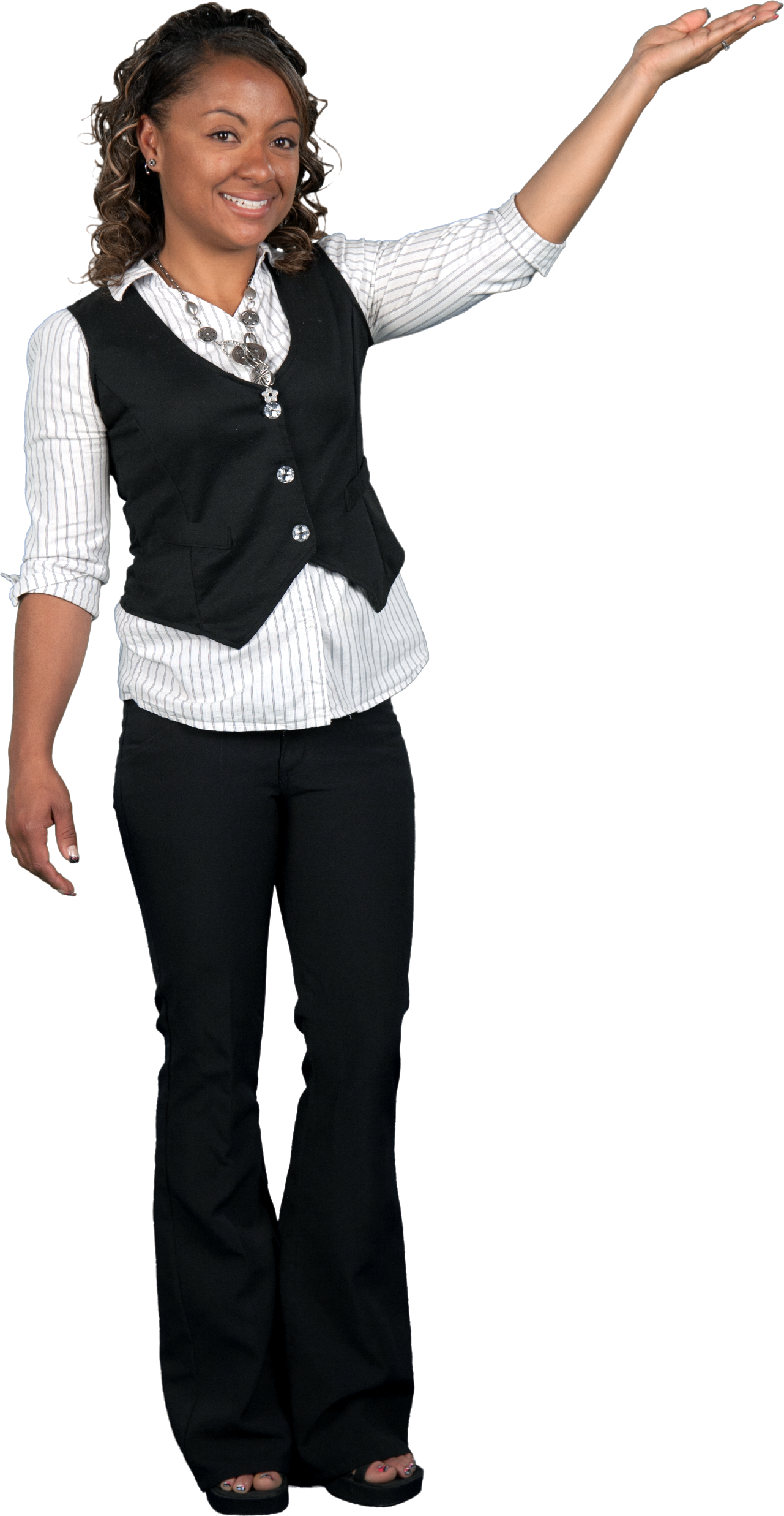
Thank You

